Slide 1
Order processing system
CODEFURY-2022
TEAM-1:BLACKKNIGHT

Slide 2
TEAM MEMBERS
Ishika Dipeshbhai Tailor​
Aniket Kumar
​Ayan Shah
Asmi Sharma
Gowtami Ramesh
Ishika Shendge
Chinnapapakkagari Sreenivasa Vikranth
Harshita Meratia

Slide 3
Introduction
Our Project titled : Order Processing System is an Implementation to demonstrate an Order Management System with key stakeholders as End User, Admin & Employee, enabling end users to order/purchase a product through an user friendly Interface while managing the records which is being managed and maintained by Employees of the System and administered by Admin. Our Project is an initiative of implementation to simulate the whole order processing lifecycle along with the feature of dynamic GST Invoice Generation features.

Slide 4
Salient features
Role Base Login : Employee and Customer
Passwords are Encrypted while Storing into DB
Employee can Create New Product and Quote
Customer can update status of each Quote
Both role can see order invoice
Product table can be edited or deleted-
Automatic GST and Ship cost is calculated

Slide 5
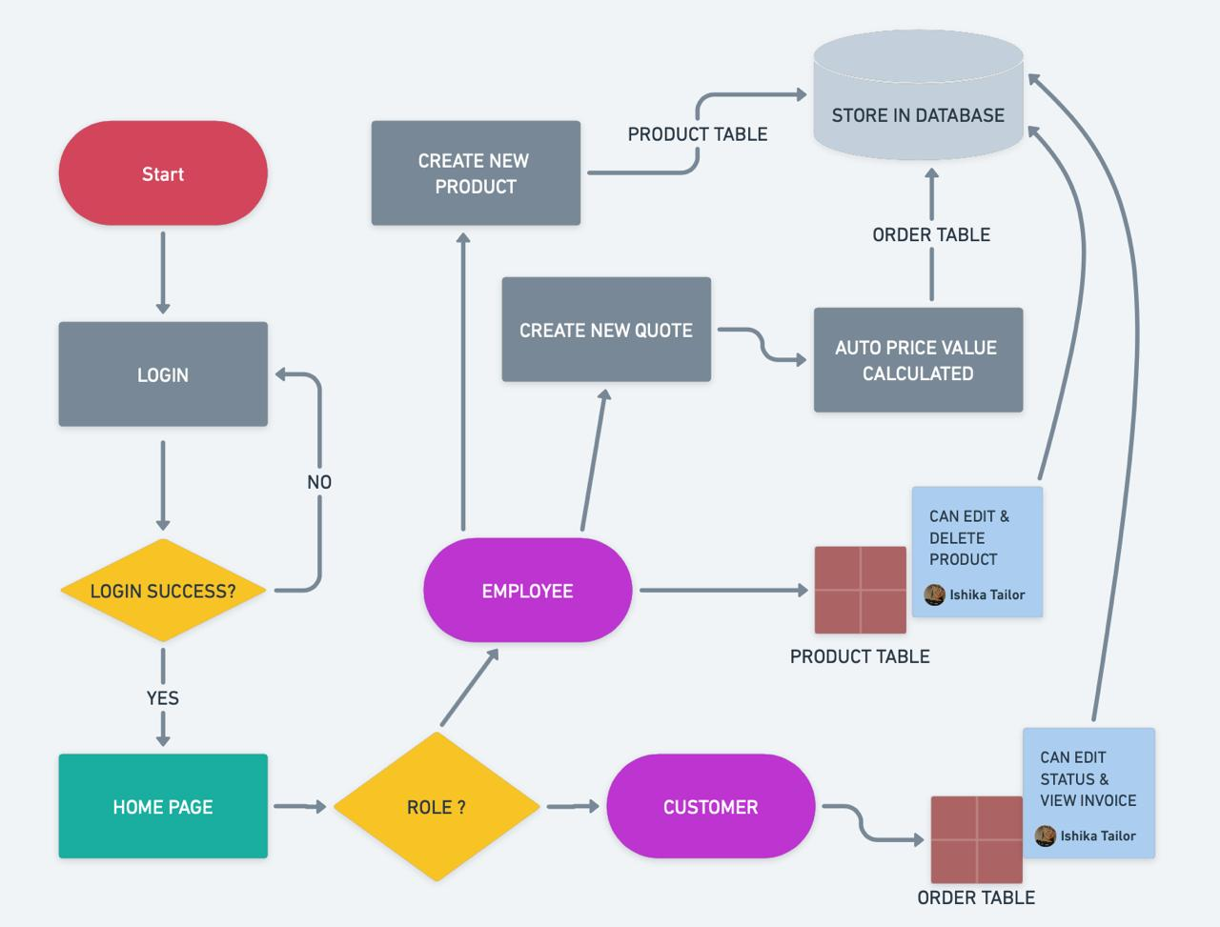
wireframes

Slide 6
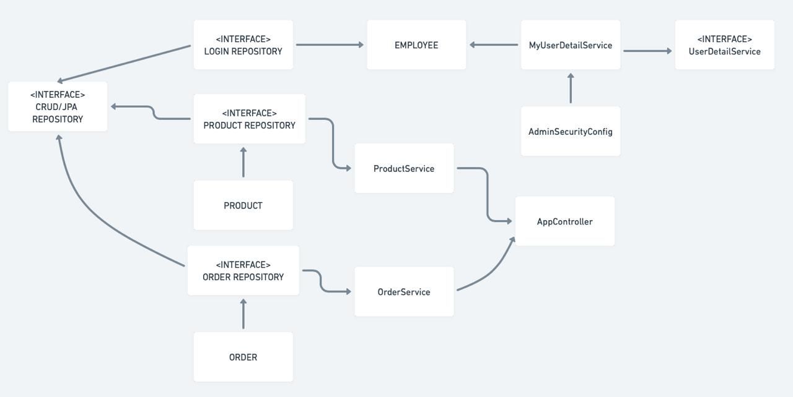
Class diagram

Slide 7
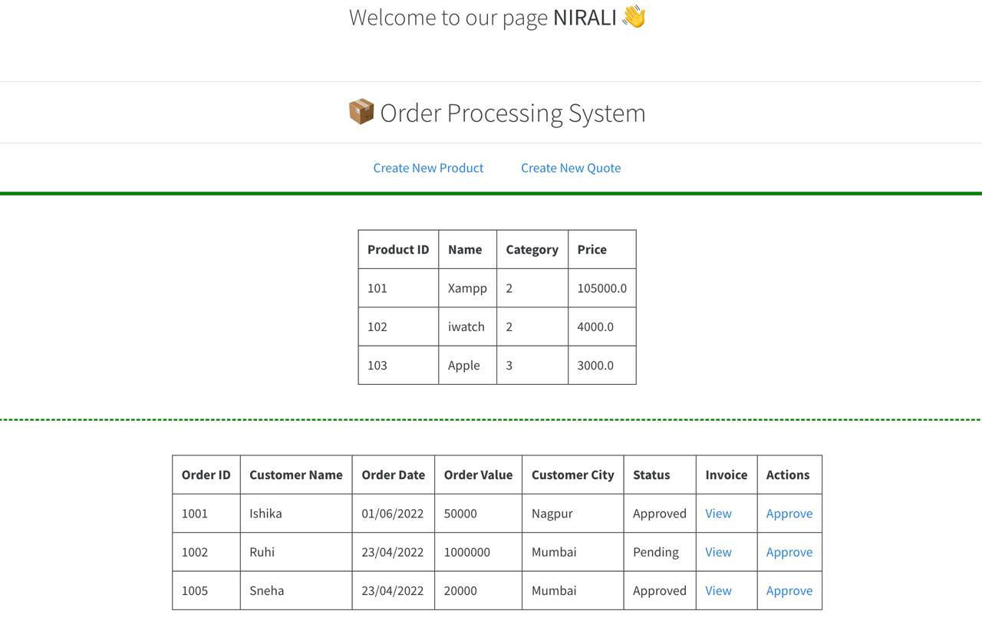
UI Snapshots

Slide 8
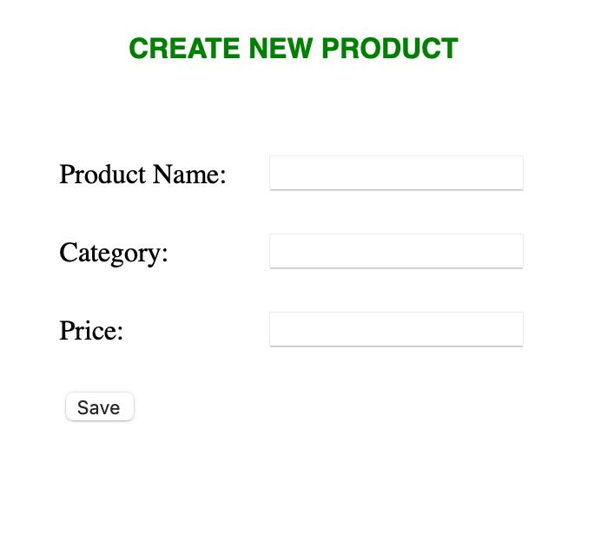
UI Snapshots

Slide 9
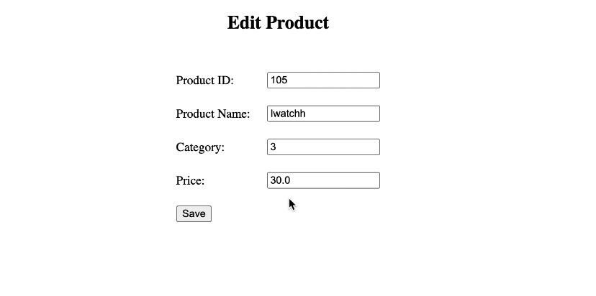
UI Snapshots

Slide 10
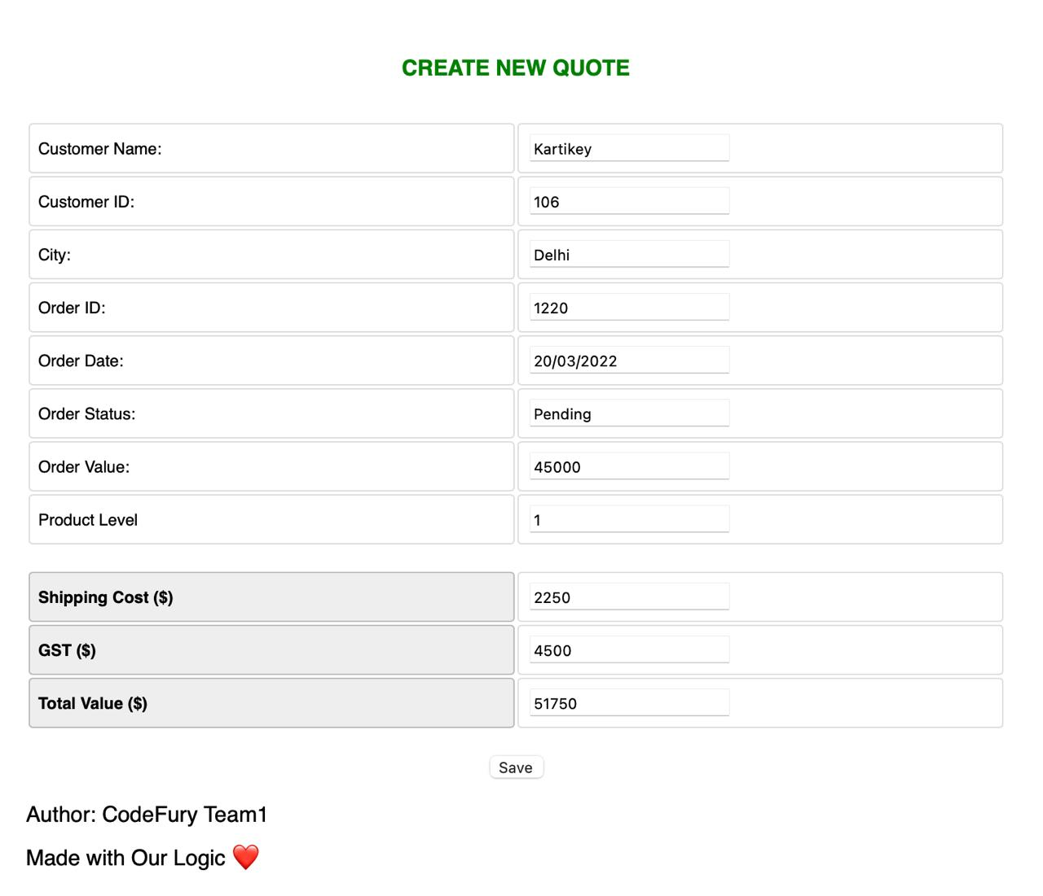
UI Snapshots

Slide 11
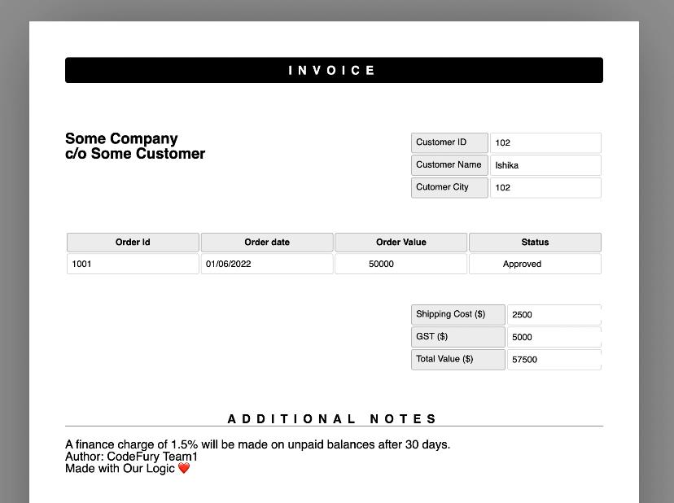
UI Snapshots

Slide 12
Concepts learned
UI DevelopMent
Springboot framework & microservices
HTML CSS Javascript & Bootstrap Templates
Agile Model
Teamwork
Team & Project Management
Implementing microservices using Spring Framework
Access, Authentication, Authorization & Privilages

Slide 13



Tools used
Intellij +VSCODE
MYSQL Db
GiTHuB|JDBC|Json Jar
IntelliJ IDE is used to Develop Application Source Code under SpringBoot Framework
VS Code IDE is Used for HTML and for Other UI Development
To Store and create tables, schemas MYSQL has been used as relational Database.
Github is Used for SCM,Collaboration & Version Control
JDBC is used to interface DB
Remote JARs like org.Jason, Jason-simple etc. is used for app dev

Slide 14
SUMMARY
An efficient & smooth implementation of asked use cases, ensuring to provide an user friendly interface while following agile model in collaborative fashion with incorporating values like “Team Playing” and “Together We Succeed” we have been able to accomplish our task.

Slide 15
THANK YOU
TEAM-1: BLACKKNIGHT

